Slide 1
Bob Stronge
bob@adviceni.net
Kevin Higgins
kevin@adviceni.net
Partnership Panel
August 2022

Slide 2
The Independent Advice Network, providing advice to those who need it most.
Who we are:
Advice NI is a membership organisation and service provider that exists to provide leadership, representation, support and services for the Independent Advice Network and people in Northern Ireland. We support 67 members across NI, who providing advice on benefits, debt, housing, employment and consumer related issues.
Advice NI also delivers a range of advice services to the public via a Freephone helpline which includes Debt & Money, Benefits, Tax Credits & HMRC products/services, EU Settlement Scheme, Covid-19 advice and Business Debt.
Notes:
Advice NI is a membership organisation that exists to provide leadership, representation and support for independent advice organisations in Northern Ireland.
We have 63 member organisations operating throughout Northern Ireland who provided advice, information and advocacy services to 263,325 people in the last year, on an extensive range of matters including social security, housing, debt, consumer and employment issues.

Slide 3
Impact & experience
Last year (20/21) the Independent Advice Network dealt with 294,515 advice enquires. This figure impacted by Covid-19 and our emergency response via the Covid-19 Community Helpline.

Slide 4
Advice & Services
Delivering advice, services and representation on
Advice
Services
Welfare Reform/Benefits
Personal and Business Debt
Tax Credits & HMRC products/services
Benefits
EUSS/Immigration
Housing
Tribunal Representation
Training
Membership
Quality
Volunteering
Policy & Information

Slide 5
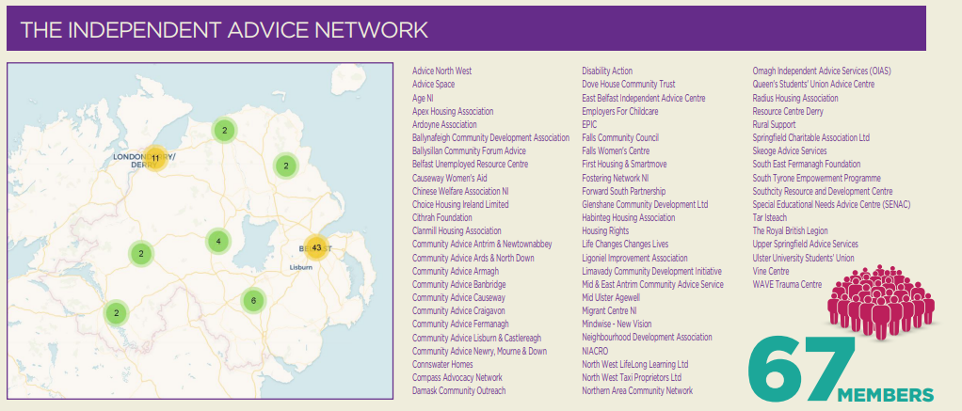
Members
We support 67 members across NI, who providing advice on benefits, debt, housing, employment and consumer related issues.

Slide 6
The importance of independent advice
Barriers preventing people approaching Government agencies directly – stigma, fear, trust;
Ability to challenge decisions – helping people secure their rights at appeal and beyond;
Offering a free, confidential, quality service based on dignity and respect;

Slide 7
Cost of Living Crisis
Background
Decade of Austerity;
Income Inadequacy;
Digital Poverty (Skills, Equipment, Data, Coverage);
Universal Credit;
Eroding Resilience;
Destitution (circumstances, personal challenges, systemic issues);
Rising Inflation
Energy Costs;
Rising Essential Food Prices (bread, meat, dairy, fruit and vegetables);
Hitting Poorest Hardest;
Rising Interest Rates
Impact on mortgages, loans, debt;
Looming Recession?
Job loss, Home loss;

Slide 8
Cost of Living Crisis
UK Government Response
One-off lump sum payments;
No benefit uprating in line with current inflation;
Fill your oil tank today, but what about food on the table tomorrow?
NI Response
‘Evason’ Welfare Mitigations; Discretionary Support financial support scheme;
Child Funeral Fund;
Period Poverty – access to items in public service premises including schools;
WWC, Energy Payment & Emergency Fuel Payment Schemes;
Food Boxes, High Street Scheme during pandemic;
Holiday Hunger food grant;
Local Response
Local initiatives targeting local need;
Independent advice, F2F crisis support;

Slide 9
Cost of Living Crisis
UK Government Response NEEDED
Benefit uprating (in & out of work) in line with current inflation;
Strengthen the social security system;
Universal Credit ‘Move to UC’ mitigate the risks;
NI Response NEEDED
@ £500m currently unspent;
Don’t focus solely on one-off lump sum payments;
Support that leaves a longer term legacy (income maximisation, insulation schemes, CWB, Help into Employment);
Safeguard people / mitigate threats to income (eg ‘Move to UC, benefit renewals, deductions, sanctions, expedite appeals);
Strengthen welfare mitigations;
Move forward with NI Executive Anti Poverty Strategy;
Local Government Response NEEDED
Tailor initiatives targeting local need: Community Wealth Building;
‘It’s the Local Economy, Stupid!’;
Maximise Community Planning opportunities;
Independent advice can provide pathways out of this crisis;

Slide 10
Advice NI Access Channels
Website: www.adviceni.net – including Policy Manifesto
Helpline: 0800 915 4604
Follow us on Twitter @AdviceNI
Like us on Facebook

