Slide 1
Community resilience and use of volunteers in emergencies
Ken Wyatt

Slide 2
Headline Statistics
1,241 offers to volunteer (as up to February 21) - 569 of those did not go through the DBS process so did not become active volunteers
1,018 households supported by volunteers (as up to April 21)
Main activities undertaken –
Prescription collection – 37%
Food shopping – 29%
Telephone befriending – 13%
Sitwell and Boston Castle wards saw the greatest number of volunteers, Maltby, Dinnington & Wales saw the least
166 volunteers are currently active (as up to April 21)
Demographics of those volunteers who responded –
94% White British
67% female
39% 55-64 years old
41% of volunteers who responded said they had never volunteered before
90% of the volunteers who responded stated their main motivation was to ‘help their community’ and 40% stated it was to ‘utilise spare time’
The majority of volunteers responding expressed a view that it made them ‘feel part of their community’ as well as giving them an opportunity to ‘help neighbours’.

Slide 7
Covid vaccination volunteers; unprecedented support for an unprecedented time
Between December 2020 and November 2021, the effort in Rotherham saw over 300 volunteers, filling over 5,000 volunteer sessions; which equates to more than 25,000 hours.
People whose lives have been transformed by volunteering,
New friendships made
Volunteers who have gone on to paid work in the health service
Placements offered to students who were struggling for opportunities
Volunteers who have gone ‘above and beyond’ to sit with, reassure and support frail people, people with disabilities and anxious people; making sure that people did receive their vaccination
Volunteers who have – regularly – done a full days work in the day; and then happily come to the clinics for another 4 hours
The many volunteers who have been with us throughout the year, and completed session after session for us - and moved on to other volunteering in health and care
Just wanted to say thank you for organising this programme. It's been a privilege and continues to be meeting lots of different characters and volunteers.
It has been a pleasure and privilege to volunteer at St Annes - very rewarding and I always appreciated your emails and reminders of what was needed.

Slide 8
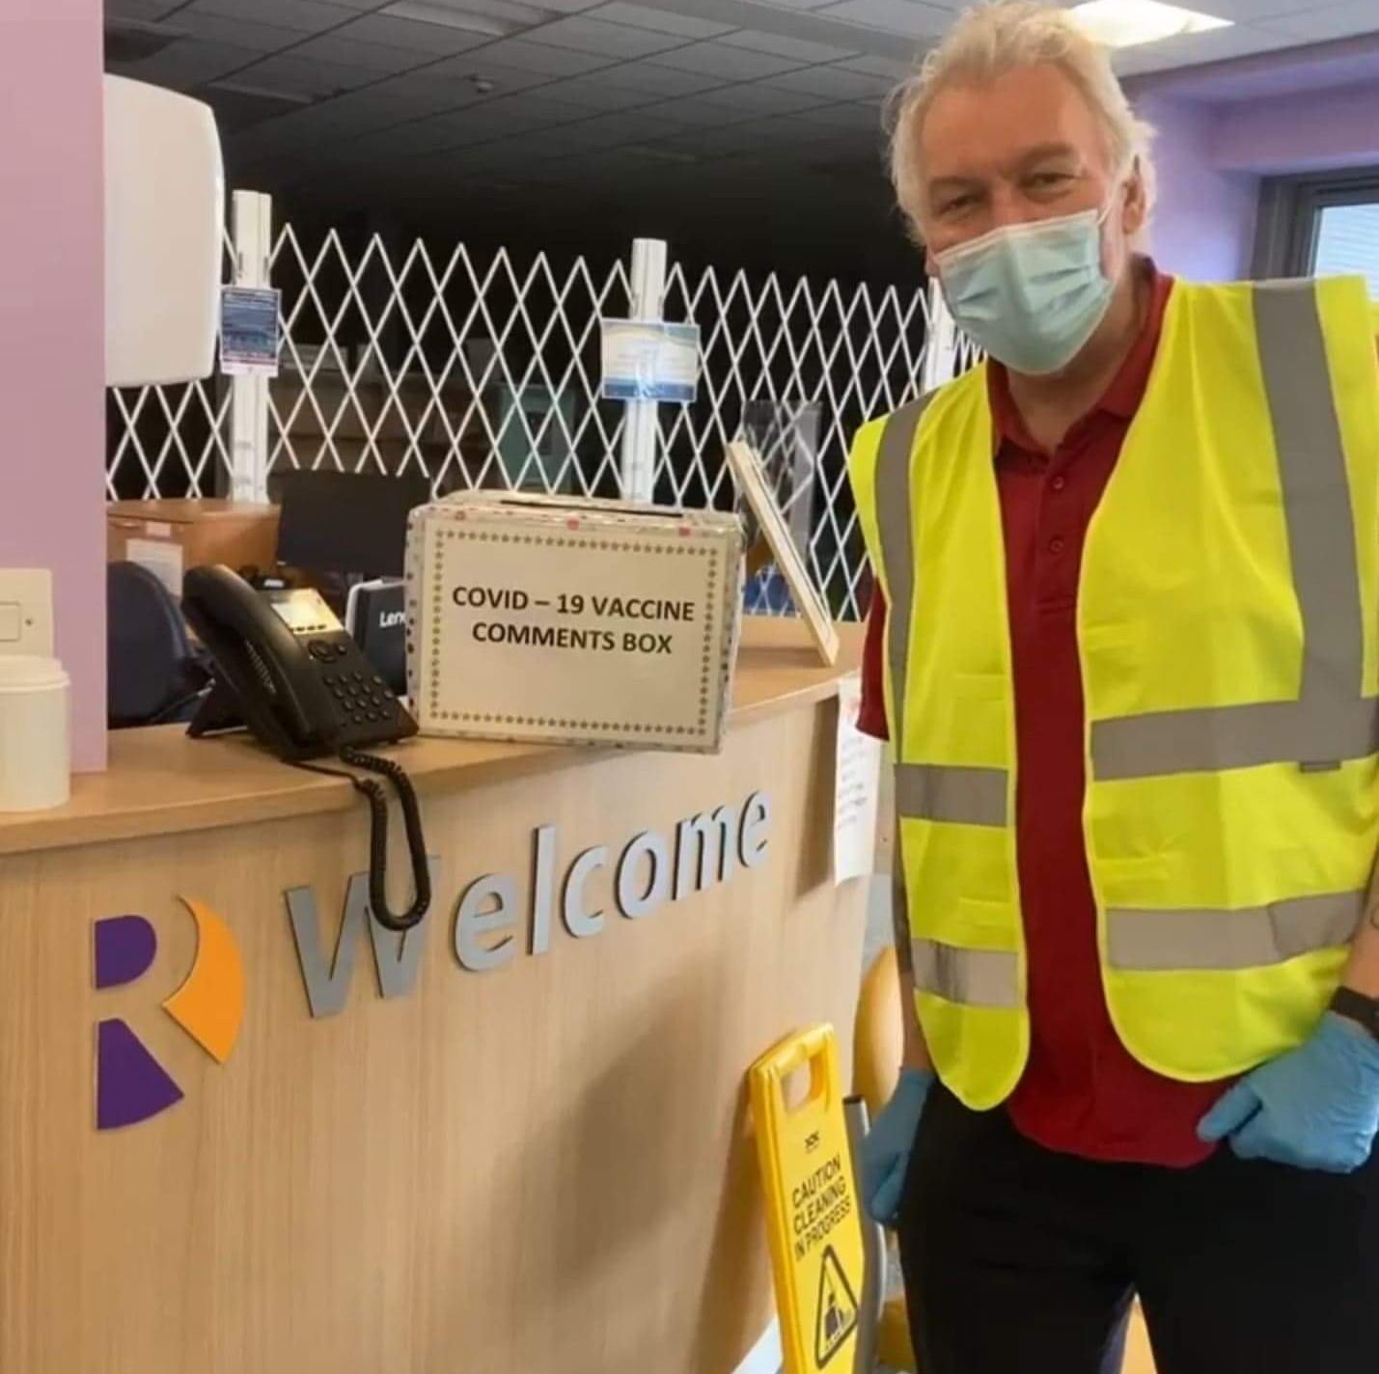
Challenging but rewarding
Challenges
‘churn’ of volunteers
Variety of experience and skills was positive as well as challenging
Staff with limited experience of managing volunteers; alongside staff availability generally (on site)
Easier to fill rotas during lockdown; harder when things ‘opened up’
The intensity and duration of the project
BUT
Some people are still working with their individual practices to support remaining vaccinations

Slide 10
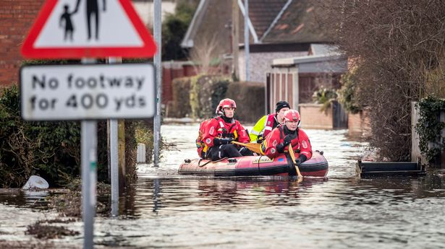
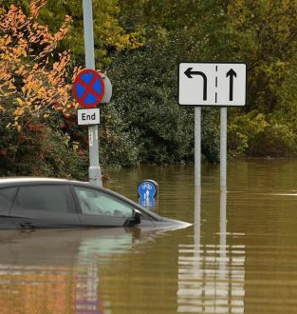
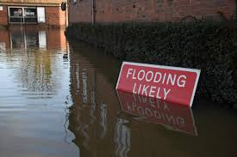
Aim:
To improve the understanding of Community Flood Resilience and enable Rotherham MBC staff and elected officials to utilise resources and information via training to help empower high risk communities within the boundaries of Rotherham MBC to understand the risk, prepare for and take action in a flood incident.

Slide 11
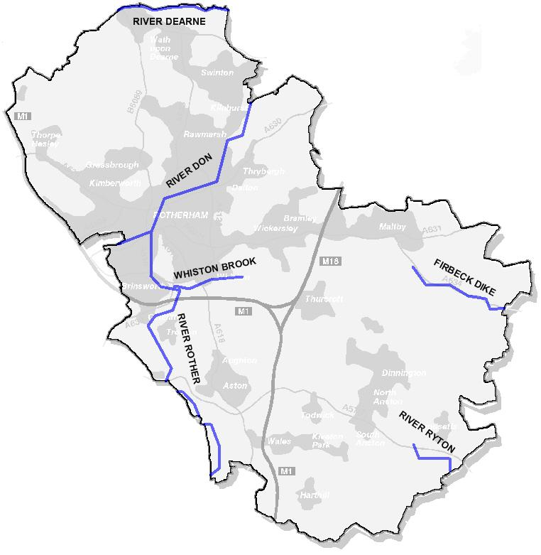
Flooding
Rotherham has experienced 4 flooding events of major local significance since 2000,
- November 2000 (localised event)
June 2007 (Nationally significant)
June 2009 (localised event)
November 2019 (Nationally significant)
The significant risk for Rotherham occurs from Surface Water Flooding with:
 | River Flooding | Surface Water (RFfSW)
Dwellings at risk | 273 | 2321

Slide 12
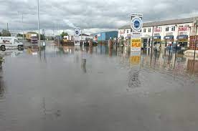
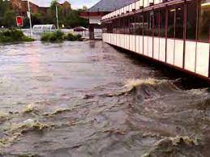
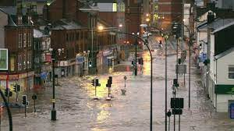
June 2007 Floods
Between 24 and 25 June some of the heaviest rainfall on record fell, with more than 90mm of rain falling in just 18 hours.
Flooding occurred to:
Properties – 428
Businesses – 406
Road Closures - 42

Slide 13
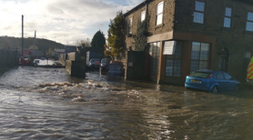
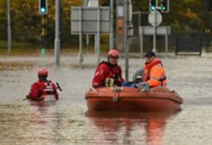
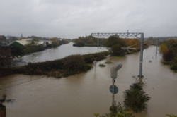
November 2019 Floods

Slide 14
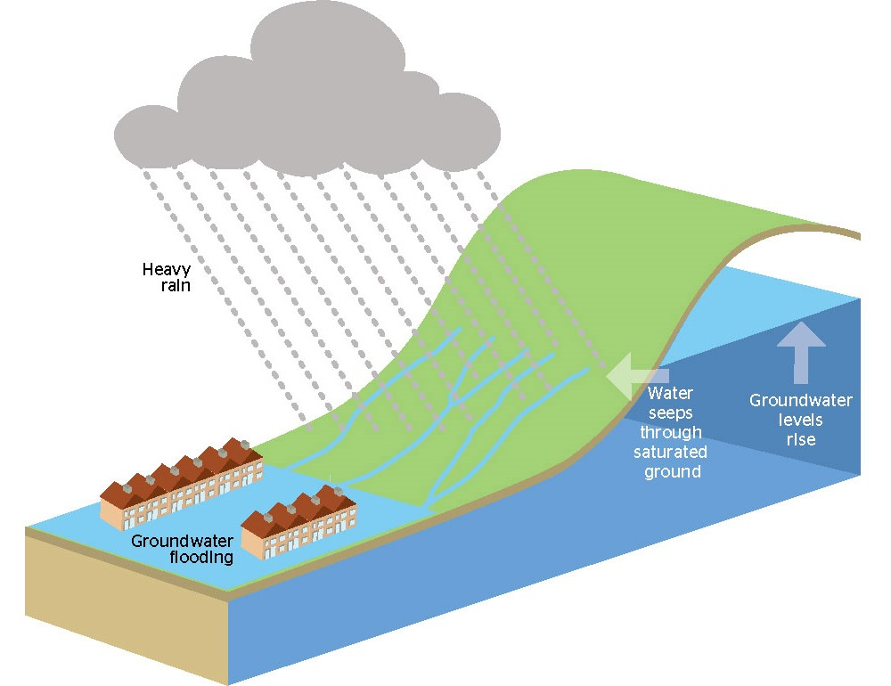
Types of Flooding
Surface Water Flooding – rainwater (including snow and other precipitation), which is on the surface of the ground (whether or not it is moving). This occurs when the drainage system, watercourse or river does not have the capacity to take the amount of rainfall.
Ordinary Watercourse – Watercourses that are not managed by the environment agency and are riparian owners responsibility. Flooding occurs when a break or failure happens or the banks of the watercourse are over topped.
Ground Water Flooding – Water under the ground defined as the water table has risen due to saturation of the land and reached the top of the soil causing flooding.

Slide 15
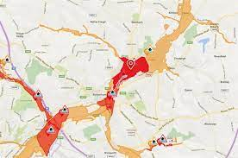
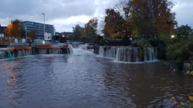
Types of Flooding Con’t
Main River – Watercourses legally defined and marked as such on the main rivers map. Generally they are larger streams or rivers, but can be smaller watercourses. The Environment Agency has flood risk management responsibility for them. Flooding occurs due to over topping or breaches of the banks.

Slide 16
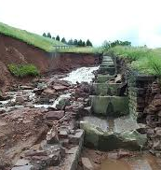
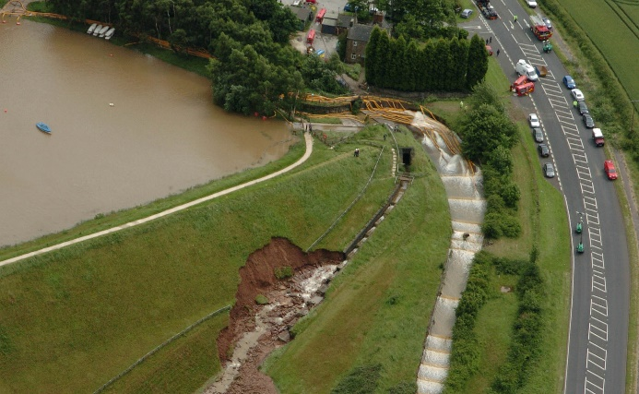
Types of Flooding Con’t
Reservoir Flooding – This is a large body of water that exceeds 10,000 m³ an example of this is Ulley Reservoir. Uncontrolled releases from reservoirs can cause flooding and this can be catastrophic and cause extensive damage to land and properties both in the immediate and neighbouring areas.
Ulley Reservoir – 2007 scour

Slide 17
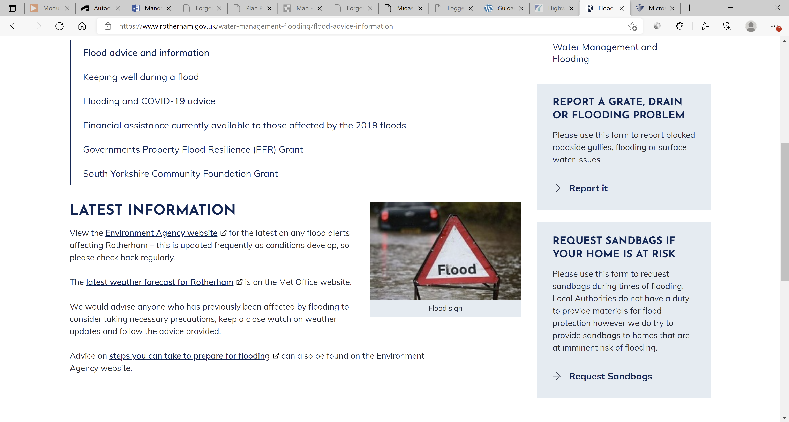
Advice on Flooding
The council has a dedicated webpage for advice on flooding, residents should be encouraged to report all flooding problems and sandbag requests through this page. Within a major event issues should be feed through the contact centre on 01709 336003.
Included is advice on EA flood warnings, the Met Office’s weather report and information on how to prepare for a flood.

Slide 18
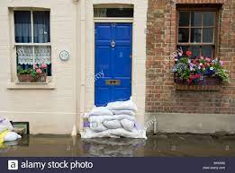
Sandbags
Local authorities are not under a duty to provide materials for flood protection but Rotherham do provide sandbags as a preventative measure during a flooding emergency
No guarantee can be given that sandbags will be provided or delivered within a specified timescale and there may be some delay in their delivery. At times of high demand restrictions may be placed on the number of sandbags made available to individual properties.
Whilst the use of sandbags can restrict flooding they will not totally prevent the encroachment of floodwater into a building
Sandbag Stock
The Council holds around 1,500 sandbags

Slide 19
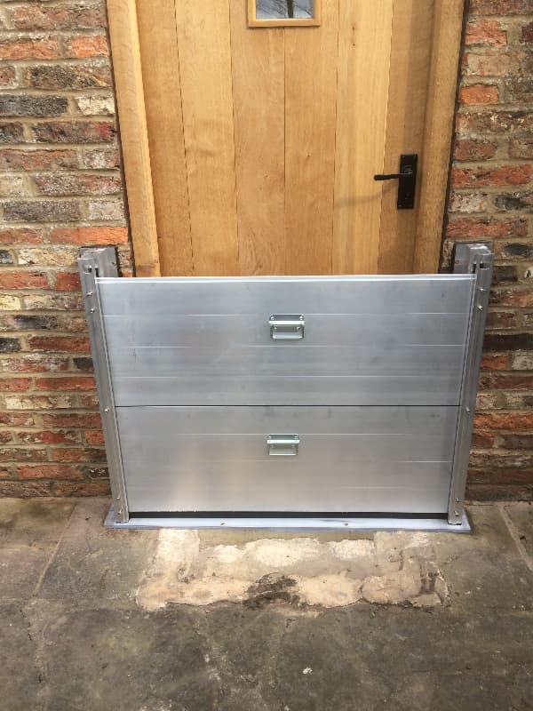
Property Flood Resilience (PFR)
Following the floods of November 2019, Defra offered each property that had suffered internal flooding £5k towards PFR.
PFR is a resilience measure and will not fully reduce the risk of flooding, however can help with recoverability of the property after a flood event.
PFR features can vary depending on the house type and flooding mechanism.
Within Rotherham there has many properties that have taken advantage of the PFR Grant.

Slide 20
Property Flood Resilience (PFR) Solutions

Slide 21
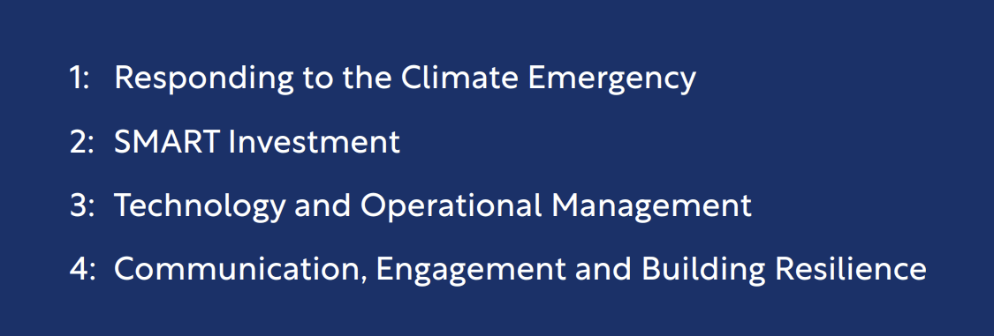
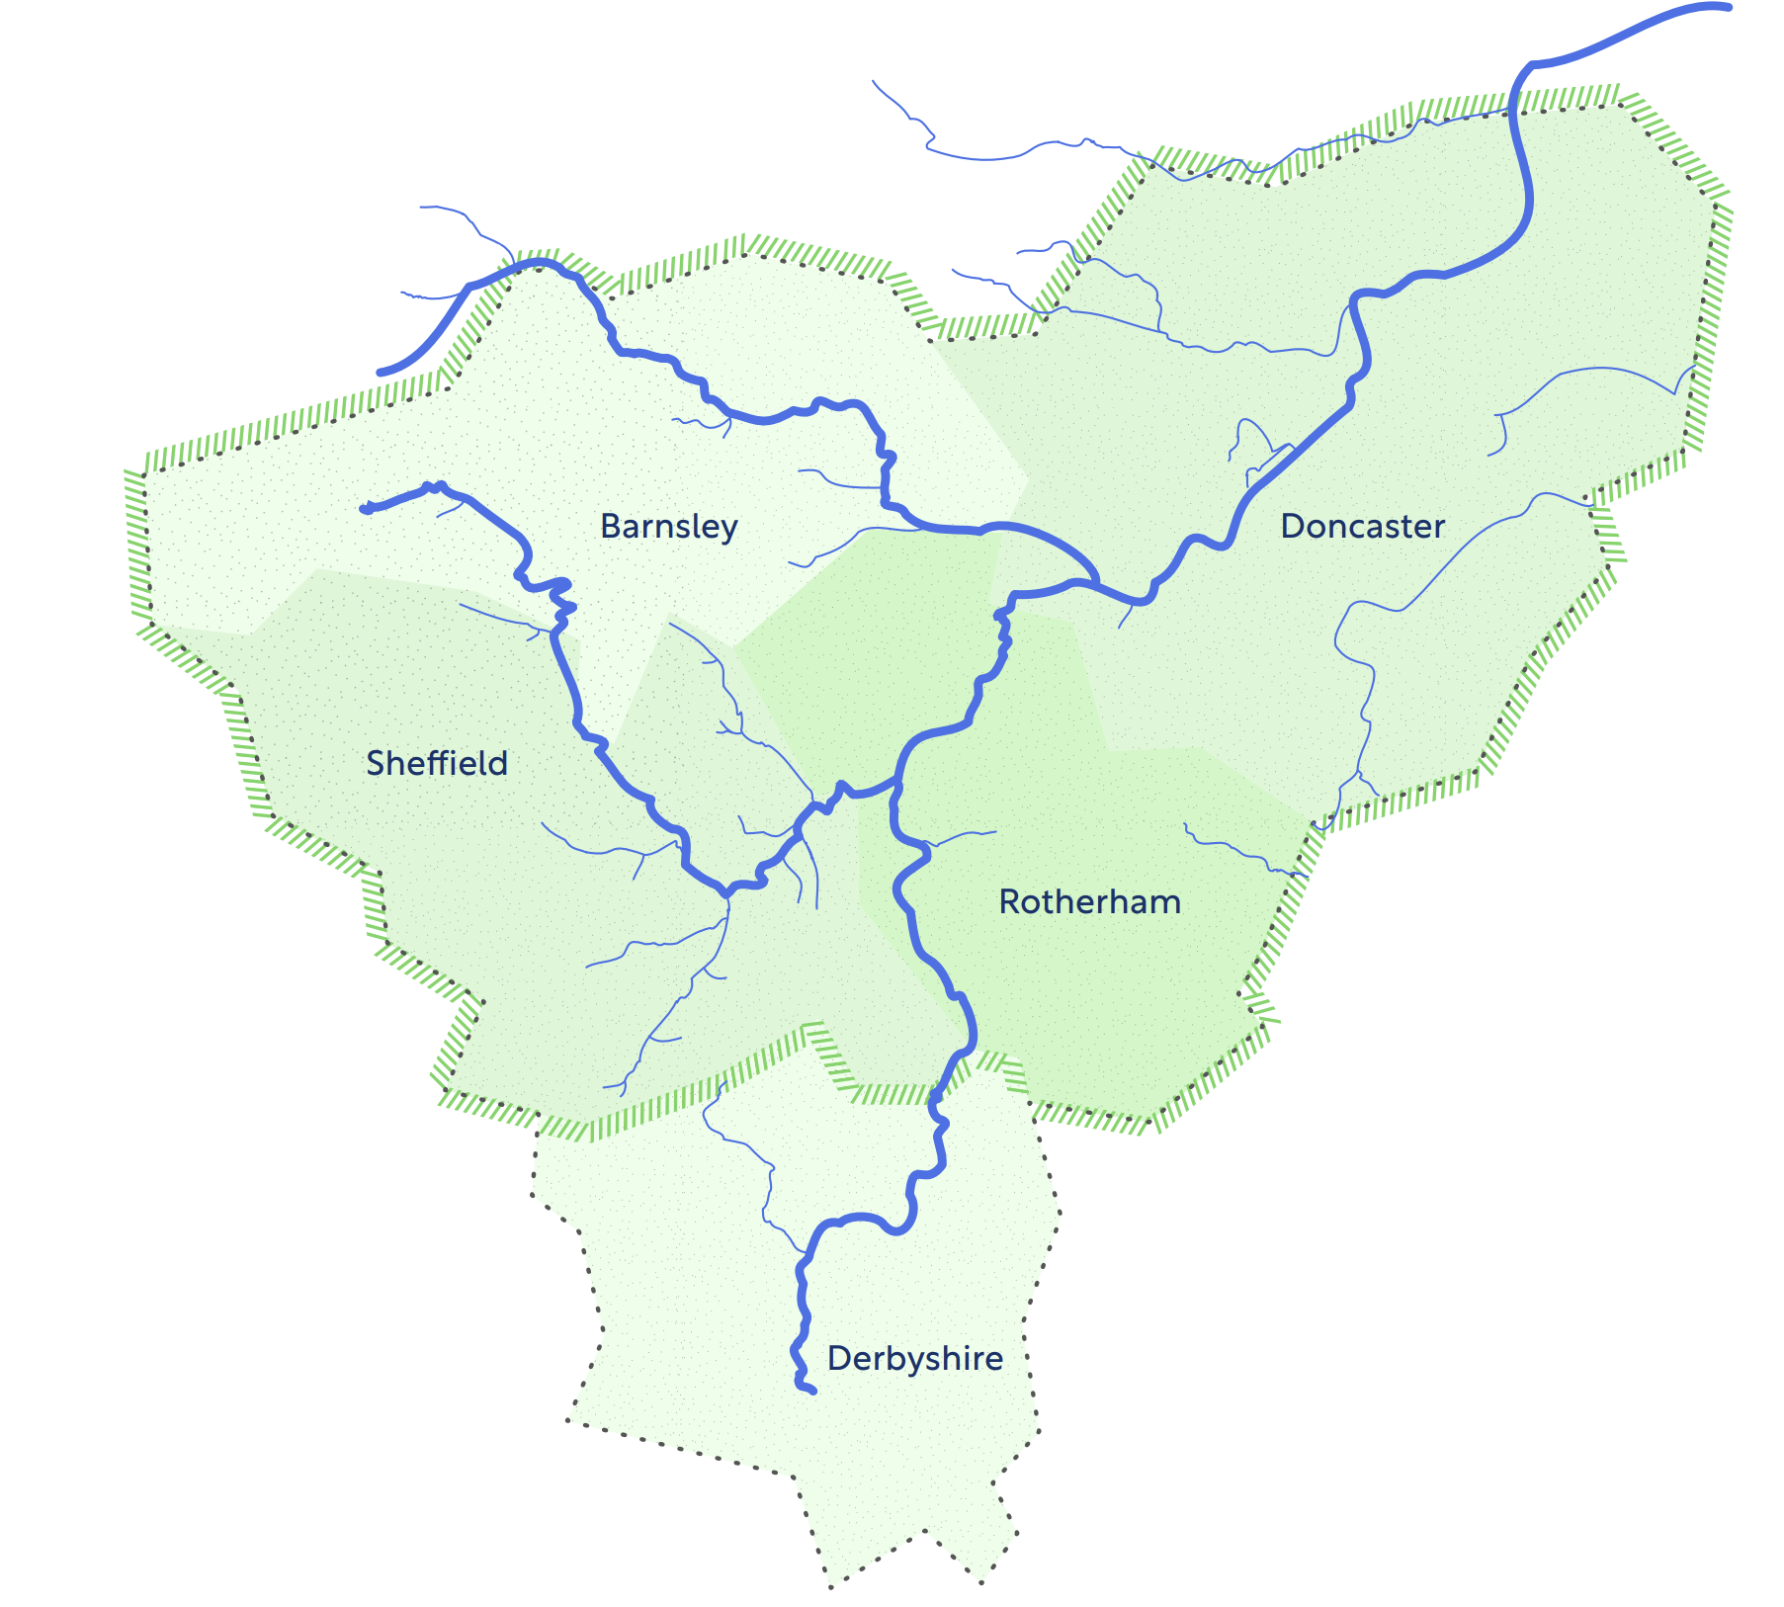
Connected By Water
The flooding in November 2019 provided the catalyst for the creation of this Connected by Water Plan. One of the wettest autumns on record led to unprecedented river levels, and widespread flooding across South Yorkshire.
Themes

Slide 22
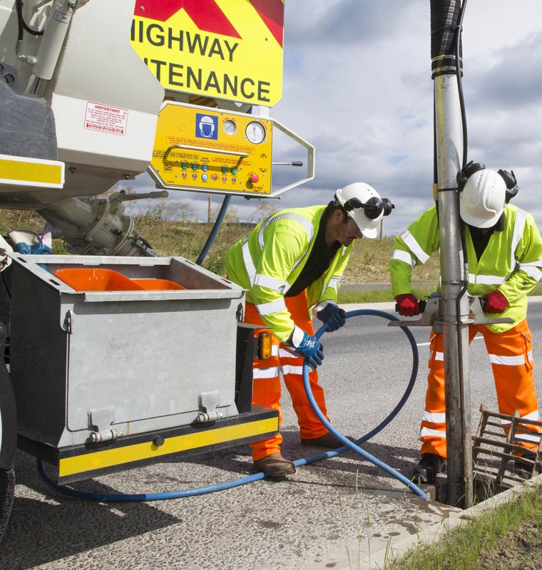
Maintenance
Rotherham Council has a vast amount of drainage assets that are maintained on a cyclical program.
Gully cleansing is scheduled to be carried out at a minimum of once per year per gully becoming more frequent on arterial routes
Soakaways, interceptors and trash screens on a 3 month program.
All critical assets within a vulnerable area are cleansed on the issue of a flood warning.
Watercourse de-silting is carried out on a reactive basis.
Highway Drainage de-silting carried out reactively.
Gullies - 45,750
Highway Drainage System – 361km

Slide 23
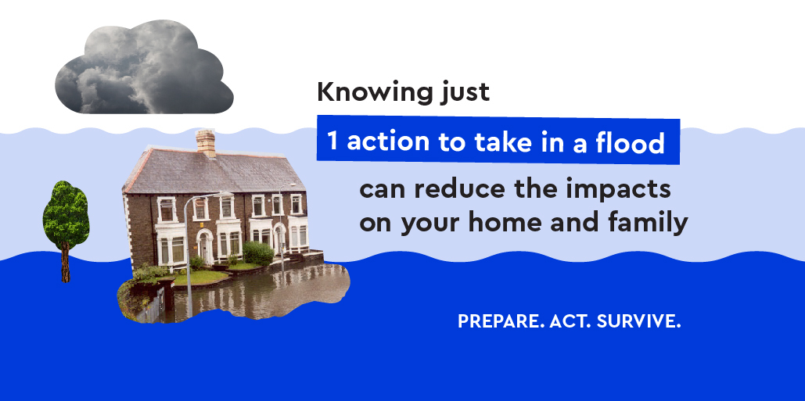
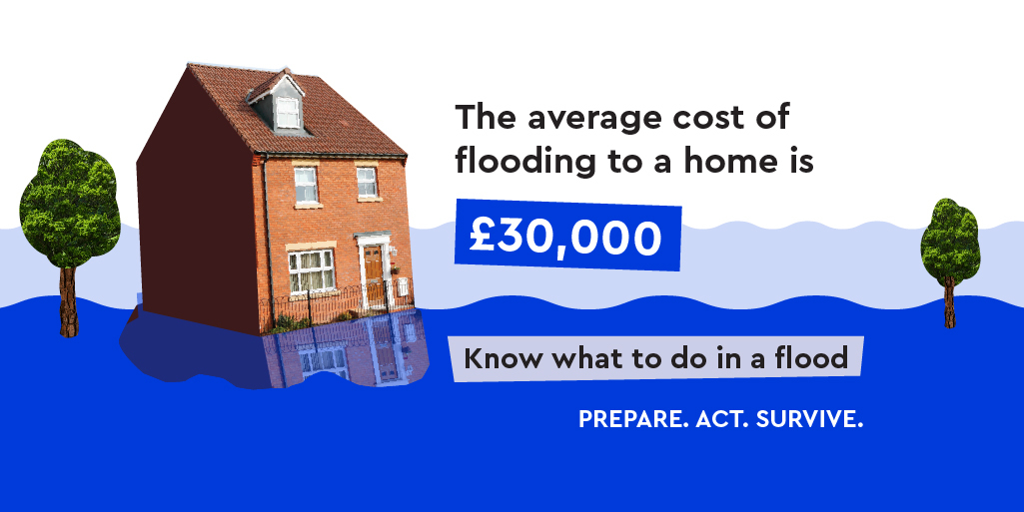
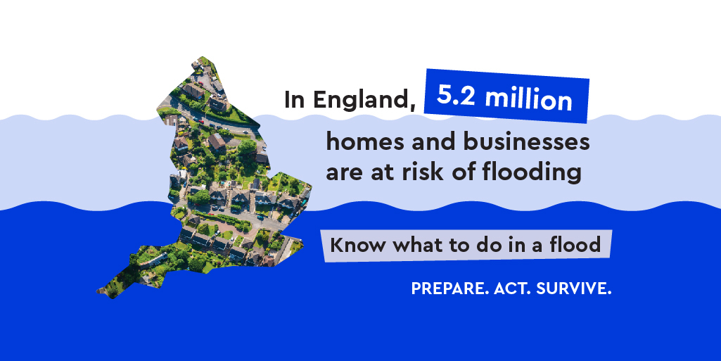
Flood facts

Slide 24
Personal flood plan
https://youtu.be/c4AP74tS0eY
https://flood-warning-information.service.gov.uk/plan-ahead-for-flooding

Slide 25
Business flood plan
floodresilientbusiness.co.uk
(small businesses)
Yorkshire Flood Resilience | Hazard and Hope (case studies)
Blue Pages (Site for accredited suppliers – hosted by National Flood Forum)
Business | The Flood Hub
(example plan and guide)
www.gov.uk/government/publications/preparing-your-business-for-flooding

Slide 26
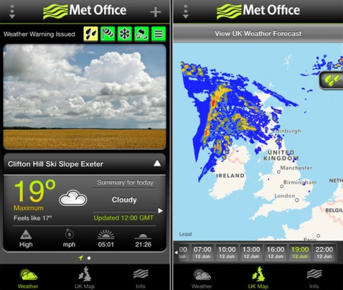
Warning and Informing
Met office App
Flood Alert App
River Levels App
Notes:
Did you know there are two types of warnings service available in your area?
These two services interact with each-other at the ‘Flood Forecasting Centre’
Where Environment Agency Hydrologists and Met Office Meteorologists discuss the weather forecast and make informed decisions about the impact the weather will have on flooding.
Met Office National Severe Weather Warning Service. Issue warnings for rain, snow, wind, fog and ice.
Environment Agency Flood Warning Direct Service. Issue alerts and warnings for fluvial, coastal flooding only. Not surface water or groundwater
Why is it important to keep up to date with weather and flood warnings?
Allows us the opportunity to be proactive rather than reactive.
Gives us an early heads up as to what is coming.
Enables us to prepare and put plans into place.
If you are a coordinator and need the alert service but don’t live in the flood alert area, give your details to your local EA officer who will ensure they are put onto the relevant warnings database.
MET Office app gives forecasts, weather warnings and live weather radar so you can see what’s coming
Flood Alert App gives a useful breakdown of data on flood alerts by area with notes
River Levels App is primarily for canoeists, but provides useful local river data on the go
This is also available online from www.gov.uk website for PC or laptop use.

Slide 27
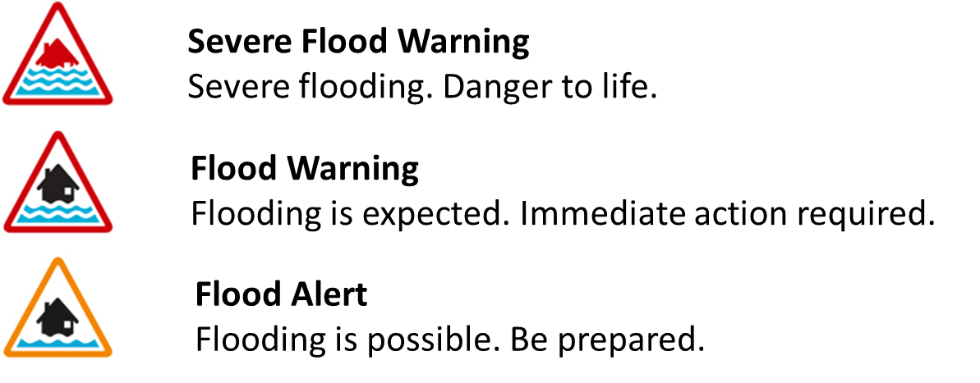
Warning and Informing
The Environment Agency maintains and provides a FREE flood warning service
We issue three different kinds of flood warnings:
Notes:
Flood Alerts are issued for large areas and will usually be issued before Flood Warnings: issued earlier – two hours to two days in advance of flooding (6am to 9pm). Often because they are large it can mean the impact is not always in your area but in another part of the catchment, but it’s always worth preparing
Flood warnings are issued when property flooding is expected to occur, these are smaller and targeted areas, the trigger is based on the First Property to Flood best known data. Best endeavours of minimum 2 hour lead time
Severe Flood Warnings are issued in conjunction with the emergency services, only when there is widespread danger to life. There is no river level trigger to issue a severe warning
If a severe flood warning is not issued, there is still the potential for danger to life – all flood water is dangerous

Slide 28
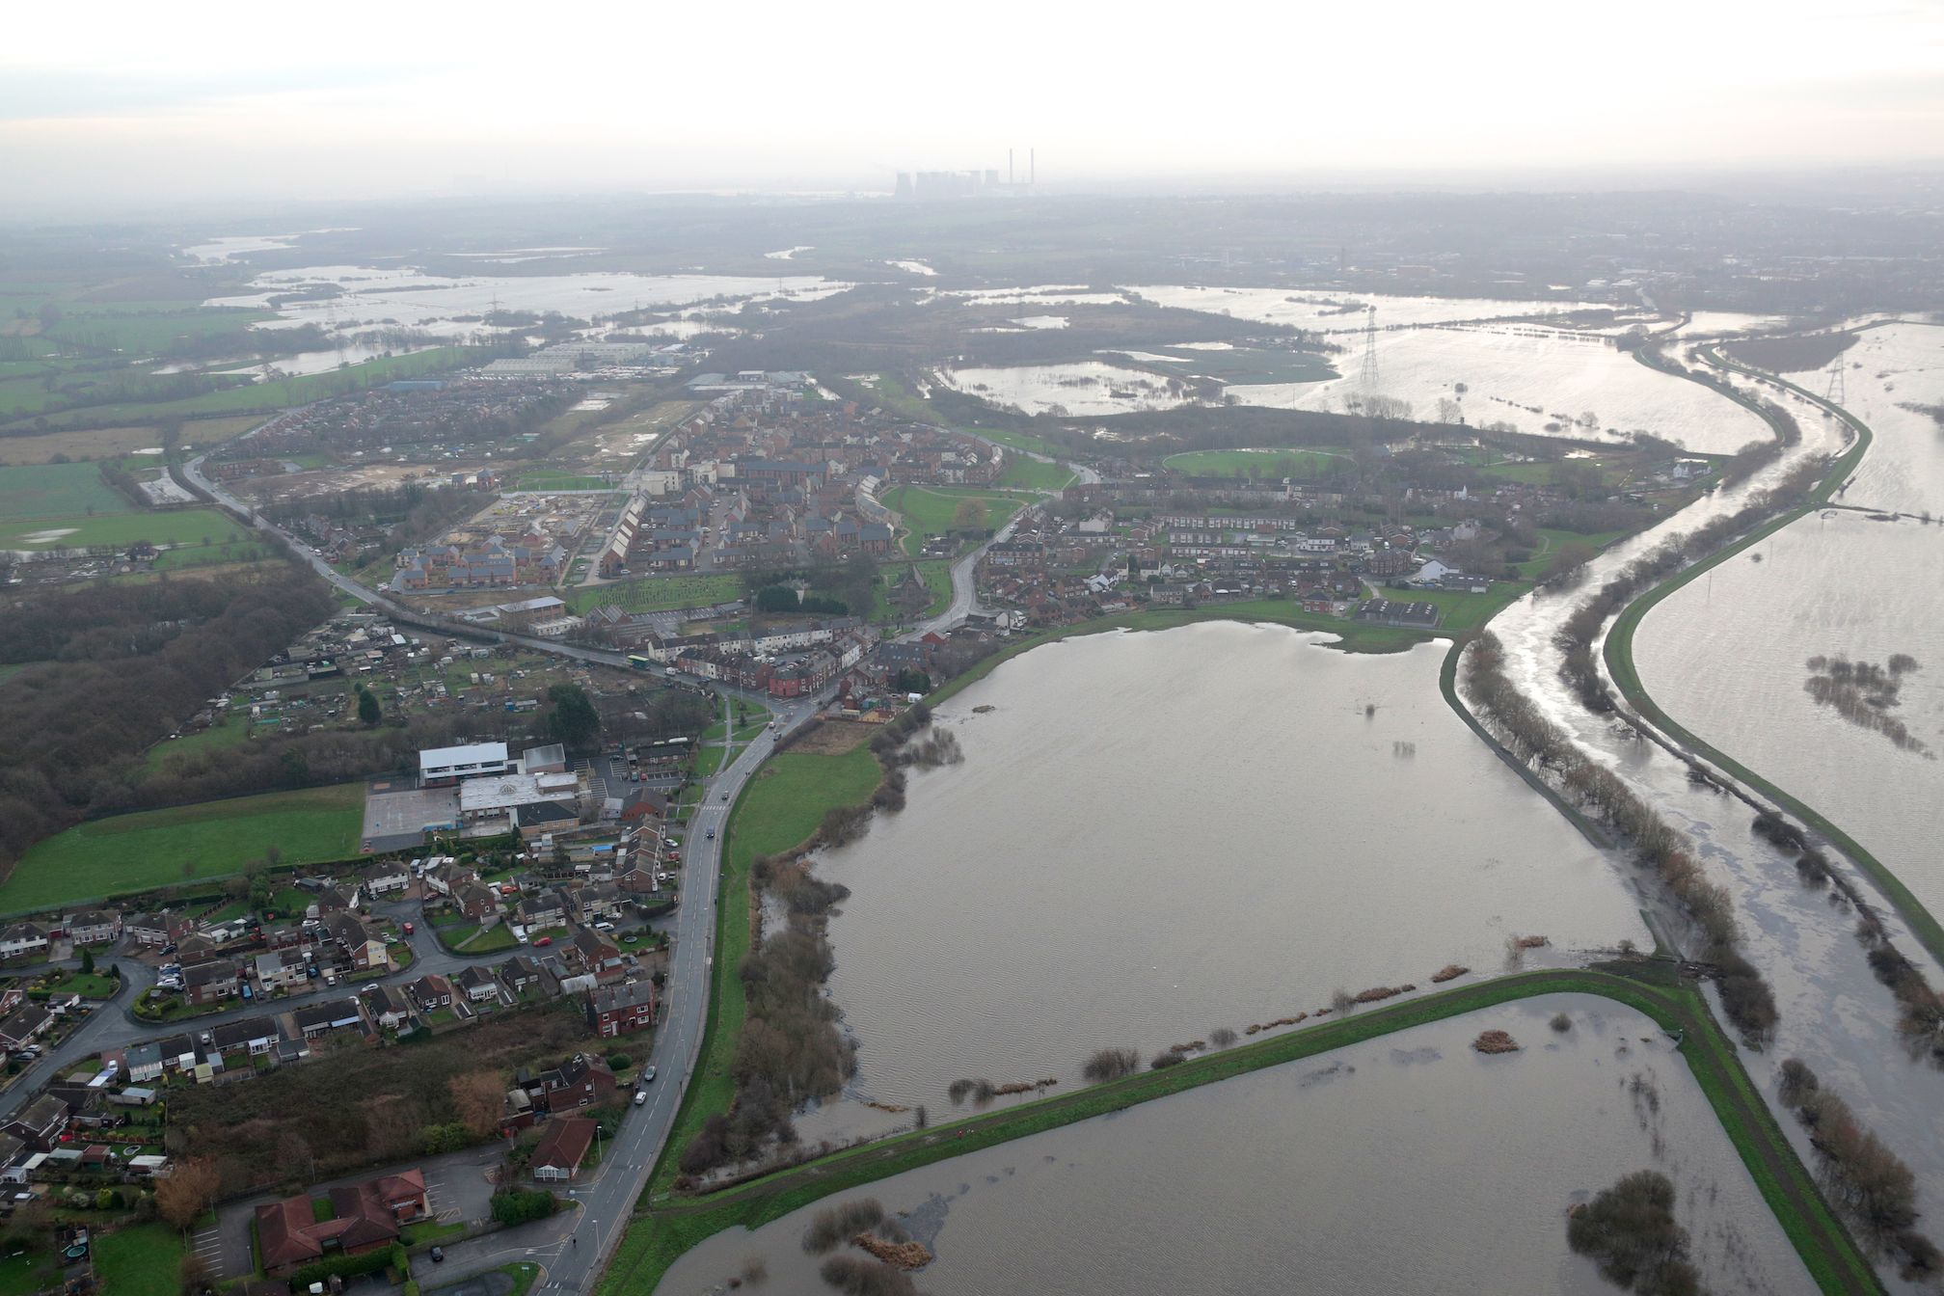
Flood Alert
Expected impacts:
Flooded fields, recreation areas, sports grounds and car parks
Flooding of minor roads
Flooding of farmland
If a coastal flood alert – spray or wave overtopping
Possible actions:
Monitor river levels
Keep an eye on the gov.uk website
Prepare a bag
Check your flood plan
Know the actions you will take if a warning is issued

Slide 29
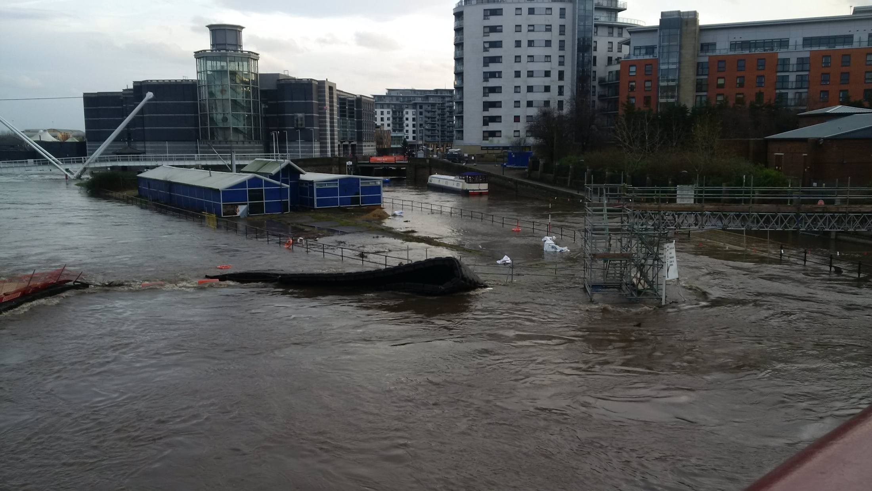
Flood Warning
Possible actions:
Protect yourself, your family and help others
Move family, pets, and valuables Put property level resilience measures in place
Turn off gas, electricity and water supplies if safe to do so.
Call Floodline 0345 988 1188
Monitor Flood Warning updates
Expected impacts:
Flooding of homes and businesses Flooding of rail infrastructure
Flooding of roads with major impacts
Extensive floodplain inundation, including caravan parks and campsites
If a coastal flood warning, significant waves and spray
Notes:
Flood Warning means flooding to property is expected. Immediate action is required.
The kind of impacts we expect: Flooding of homes and businesses Flooding of rail infrastructure
Flooding of roads with major impacts
Extensive floodplain inundation, including caravan parks and campsites
If a coastal flood warning, significant waves and spray
The advice we provide with a flood warning. These are suggested actions – and depending on the flood risk at your home- we recommend people take actions that are appropriate to them.
Protect yourself, your family and help others
Move family, pets, and valuables Put property level resilience measures in place Turn off gas, electricity and water supplies if safe to do so. Call Floodline 0345 988 1188

Slide 30
Flood Warnings (Yorkshire)
75
Flood Alert Areas
570
Flood Warning Areas
Percentage of issued warnings that are severe
0.04%
Notes:
To give an idea of the numbers involved in flood warnings across Yorkshire:
There are 75 Flood Alert Areas across Yorkshire and 565 Flood Warning Areas across Yorkshire
Out of a total of 2497 warnings issued in Yorkshire between 2013 – 2020, only 41 were severe warnings – 0.04%
Giving that stat because there is often a misunderstanding around the frequency of this warning and when it is issued and residents waiting for the severe before taking action.

Slide 31
Warning and Informing
Flood Forecasting Centre
Modelling and Forecasting Duty Officers
Flood Warning Duty Officers

Slide 32
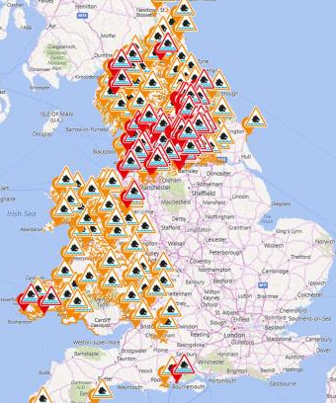
Warning and Informing
26 Dec 2015
Notes:
2015 Boxing day floods saw 107 Flood Warnings issued across Yorkshire over a 3 day period
Every warning is manually monitored, confirmed and issued by a Duty Officer
We use computer flood forecast simulations to predict flooding and monitoring equipment to record rainfall totals and river levels.
Accuracy of flood warnings improves over time as we better understand how the river reacts to heavy rain.
In some circumstances there may be no time to issue a flood warning in advance so it's important to be prepared, know the signs to look out for and stay alert.
Our teams do monitor warnings and update them if the situation changes, and these updates will be issued along the same channels as the initial warning.

Slide 33
Message
Recommended actions
Predicted time of impact
Flooding mechanism
The Detail:
This Flood Warning has been issued as strong to gale force winds combined with high tidal levels in the River Humber are expected to create overtopping waves and wind-blown spray at Hessle Haven tomorrow morning between 08:45 and 09:15, Thursday 19/11/20. Please stay away from frontages around Hessle Haven as large waves can be dangerous. Strong winds and large waves are expected to continue during Thursday, and so further Flood Alerts and Warnings may be issued for subsequent tides. Activate your flood plan and check gov.uk/flood for future updates. We are constantly monitoring the situation and will update this message by 10am on Thursday, or as the situation changes.
Event duration
Expected next update

Slide 34
Flood Warning Service
Customers can register for flood warnings via:
https://www.gov.uk/sign-up-for-flood-warnings
or
Floodline 0345 988 1188 (24hrs)
Extended Direct Warnings
Managing your own account
Choose warnings to receive (incl. Area of Interest)
Add up to 20 contacts per staff account, 6 per home & business

Slide 35
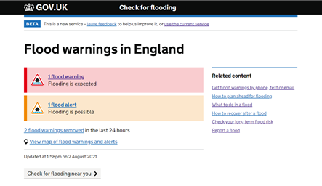
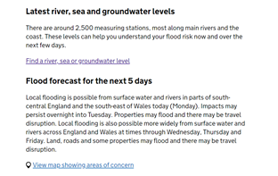
Check for Flooding
The Check for Flooding service is found on the Gov.uk website
Latest Alerts, Warnings
5 day Flood Forecast
Complements the Flood Warning Service and information from Duty Officers
Notes:
Check for Flooding replaced the previous service, the flood information service, in October 2021. The new service was built in response to user feedback and research, bringing together flood warnings, river and sea levels and the 5 day flood forecast into one place so that a user has a complete overview for the location they are interested in.
Here a user can see the total number of Alerts, Warnings and Severe Flood warnings that are in force
CLICK - Below flood warning you can choose to check the latest river, sea, groundwater and rainfall levels.
Following that the 5 day forecast is displayed, showing the national overview

Slide 36
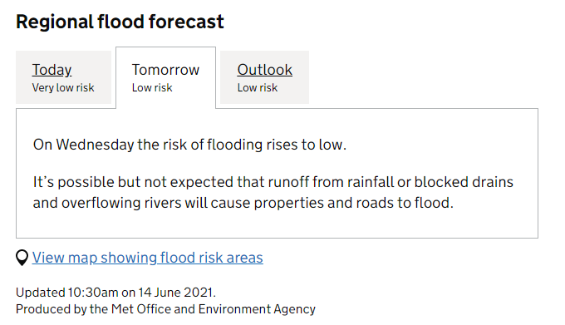
5 Day Forecast
Flood risk across England for the next 5 days
Map to show areas of concern when low risk of above
Notes:
The 5 day flood forecast gives a high level overview of the flood risk nationally or by region. It is a product produced by the flood forecasting center, a joint venture by the Met office and Environment agency.
A map showing the areas of concern will be displayed when areas are classes as low risk or above. If the map is not displayed we do not anticipate widespread issues from flooding, however some localised impacts could occur. Please refer to Hazard Manager for further information.
From the map you can zoom into a location of interest, select the forecast over the next 5 days and select the risk polygon to view the forecast information.

Slide 37
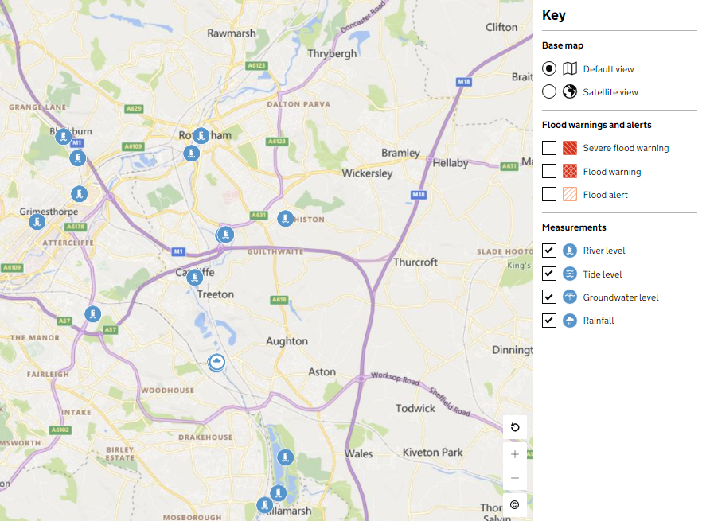
Water level gauges
https://check-for-flooding.service.gov.uk/
Notes:
Below the flood warning information you can select to view the latest river, sea or groundwater levels. Selecting this option from the national summary page takes the user to the national gauge page, listing all types of gauges.
You can choose to search for a specific location, filter the list by the name of the river or filter the list based on the type of reading they wish to see, river, coastal, groundwater or rainfall.
There is also the option to display the location of the gauges on a map by choosing the "view map" link above the list of gauges.
Choosing the map option from the gauge page will default to having all gauge options selected. The key to the right of the map shows the different symbology used for each gauge type. These symbols will appear once you zoom in to location on the map and will appear darker if the reading at the gauge is high.
The decision to issue either an Alert or Warning is not solely based around river levels as shown in Check for Flooding – other variables are reviewed such as forecast, incident size and any on the ground information that may be available. In the case of a Flood Warning, duty officers will be considering all the information available to them and assessing whether there is a risk of levels causing property flooding. This means you may see a gauge passing the point at which a flood warning may be issued, but if the forecast information held by Duty Officers suggests water levels will drop soon after, without property flooding being likely to occur, the warning may not be issued.
Some gauges are also used to monitor multiple Flood Warning Areas, so it is useful to bear in mind that where "Property Flooding Possible“ is written, this may refer to one of several warning areas (as there can be multiple warnings linked to each gauge), and may not refer to the specific warning area a user is interested in.

Slide 38
The Multi Agency Flood Plan
(1) Context
(2) Strategic LRF Arrangements
Flood Risk and Impacts
Multi Agency Response
(3) LA Tactical Flood Response and community information

Slide 39
Rotherham Flood Response Annex
Options
Flood Mitigation Resources
Decision to Evacuate – with template evacuation record cards
Identifying Vulnerable Persons
Flood Rescue - SYFR
Emergency Rest Centres - Rest Centre Plan
Humanitarian Assistance (inc Vulnerable Persons)
Public Information and communication
Identifying Critical Infrastructure
Traffic Management
Environmental Considerations
Animal welfare
Business liaison
Flood Recovery
Data Collection
Roles and Responsibilities (Council services and on call officers)
Flood Alert and Warning Areas
Information tables for each flood warning area – no. known properties at risk, infrastructure at risk, previously affected locations and any mitigations in the area
Key Partner Infrastructure

Slide 40
Our thoughts will be around….
Liaising and working with partners including Parish/Ward Councils – sharing and receiving information
Warning and informing
Mitigating actions (gully cleaning for example)
Provision of Resources – sandbags?
Highway Management - Road closures and diversion
Drainage
Evacuation and Door Knocking
Rest Centres (or otherwise shelter)
Identifying vulnerable persons
Mapping
Data and information collection and monitoring
Contact centre helpline
Recovery

Slide 41
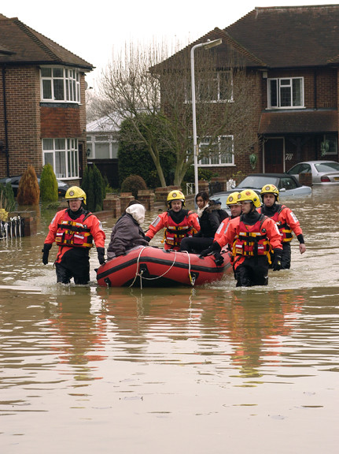
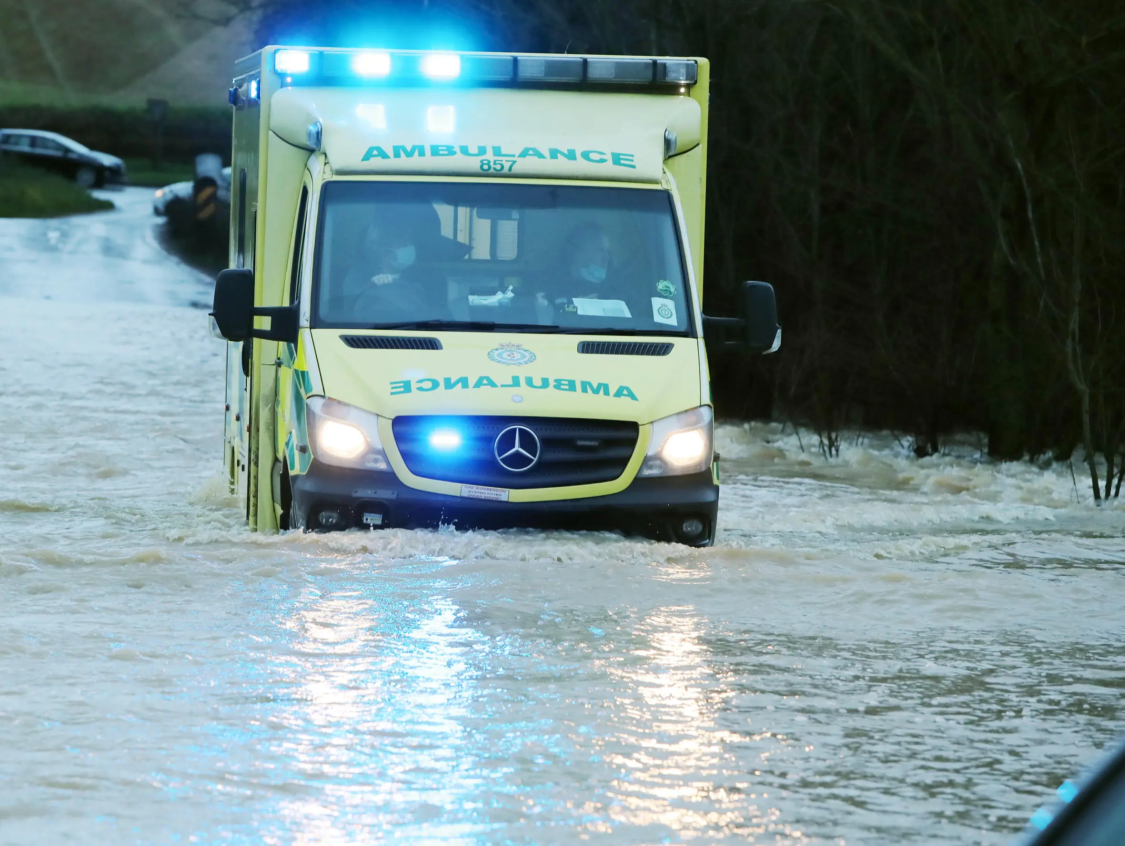
Roles and Responsibilities of Emergency Services Partners

Slide 42
Community Emergency Volunteers

Slide 43
Communities Prepared
National community resilience programme
Equipping communities faced with a range of emergencies to safely and effectively prepare, respond and recover
Building knowledge and confidence through:
Tailored support and training
Membership of our online resources hub for volunteers and partners (www.communitiesprepared.org.uk)
Facilitating networks
Notes:
Run by the charity Groundwork
Partners including the Environment Agency
Aiming to build knowledge and confidence amongst community volunteers across England
A modular training programme, starting with an introduction to emergency response followed by issue-specific training on flooding, snow, utilities failure, and public health emergencies. These draw upon existing initiatives and expertise from across the emergency response sector, resulting in a series of engaging and accessible resources that can be used and adapted by CEV groups and supporting organisations at a local level.
More than just training – wider support, strategic partnerships, recognising successes (award scheme in development), further growth of community resilience (e.g. collaboration, TtT)

Slide 44
Community Emergency Volunteers
Community Emergency Volunteers
What are Community Emergency Volunteers (CEVs)?
Communities using local knowledge and resources to help themselves to:
Be better prepared to cope during an emergency
Assist the emergency services
Recover more quickly
Creating a more resilient community
Notes:
But first let’s take a step back – what is the role of CEVs in emergencies? Various other names can be used too!
This should all be supported by a community emergency / flood plan – see below

Slide 45
What do CEVs do?
Eyes and ears for / share local info with responder agencies
Know local risks and have a plan to manage them
Community emergency plan – training / activities / implementation / review
Keep an eye on flood / weather warnings
Know and support vulnerable / at risk community members
Keep the community informed and aware
Support the community’s longer-term recovery
Notes:
For more specific roles / responsibilities see our role-specific training modules – available on our online hub or look for upcoming training sessions.
Plus there’s a bit more to come on flood volunteer roles later on in this session

Slide 46
Getting started & sustaining interest
Top tips:
Have a group coordinator
Involve your Parish / Town Council
Be proactive and visible
Recruit a diverse range of volunteers
Regular training & exercises
Multi-role
Build partnerships
Ensure you have a community flood
/ emergency plan
Ask us about our volunteer recruitment workshops if you’d like to find out more
Notes:
Tips:
Identify a ‘community Coordinator’
Share responsibilities & involve your parish council
Recruit volunteers who are personally “at risk” & “not at risk” of emergencies such as flooding. Their insight during planning can be helpful although they may not be able to help during an emergency
Recruit volunteers by targeting specific individuals
Consider a structure that allows everyone to take part
Hold regular events such as crowd marshalling or table top exercises to test procedures & training
Incorporate other emergencies in addition to flooding. We can assist with planning and training with other roles
Use a variety of communication strategies
Work with the flood risk authorities & emergency services
Work with existing groups & organisations. You can learn a lot from other similar groups in your area if you are just starting or share training between small groups. The Cat 1 and 2 Agencies are always willing to engage with their local communities and many will have volunteer training programmes you can link in with

Slide 47
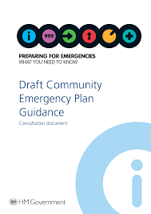
Community Flood / Emergency Plan
Predetermines how a community would respond to an emergency:
Risks and mitigating actions
Procedures and priorities
Coordination, support and guidance
Sharing local knowledge, issues and concerns
Notes:
Explain to the group that a Community Emergency Plan sets out in writing how your community responds to emergencies. It’s useful to have one so that everyone knows what should be done during an emergency. Emergency plans should be kept as short as possible (You haven’t got time to read a book in an emergency!). Bullet points and plain English!
A Community Emergency Plan example is available for downloading on our hub should your community not have one already or wish to update an existing one – it’s also worth checking out if your local authority has created a template which you could use.
It’s important to note the benefits of a Community Emergency Plan:
Provide coordination, support & guidance to the community ahead of the arrival of the Emergency Services.
Help share local knowledge during an emergency to assist the Emergency Services.
Help relay local knowledge, concerns & issues to relevant authorities & utilities before & following an incident

Slide 48
Introduction to Community Emergency Plans
Introduction to Community Emergency Plans

Slide 49
Introduction to Community Emergency Plans
Introduction to Community Emergency Plans
https://www.youtube.com/watch?v=OAS4TfieEiQ – Environment Agency video
Notes:
Explain to the group that a Community Emergency Plan sets out in writing how your community responds to emergencies. It’s useful to have one so that everyone knows what should be done during an emergency. Emergency plans should be kept as short as possible (You haven’t got time to read a book in an emergency!). Bullet points and plain English!

Slide 50
Key components
Location description
Local assessments – risk, resources and skills
Contacts list – emergency / other, e.g. community organisations, contractors
Volunteer emergency communications plan – e.g. telephone tree
Volunteer roles and capabilities, including types of emergency covered
Actions to be carried out:
Who / When (triggers?) / How / Equipment needed
Map of local area, highlighting:
Hazards
At risk locations and properties (including vulnerable residents)
Equipment locations
Other local considerations

Slide 51
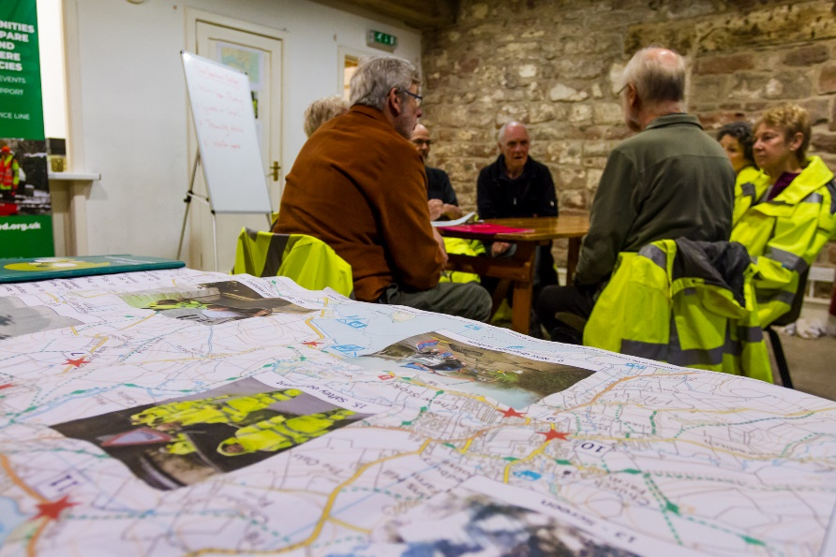
Tips
Keep as short as possible (bullet points and plain English)
In written and map form
Keep it in a secure place – may need to be accessed 24/7
Multiple copies
Practice using it – exercise your plan!
Review it regularly
Free templates available – choose what works for you

Slide 52
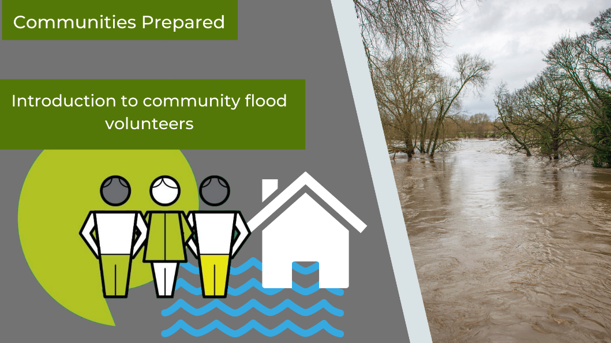
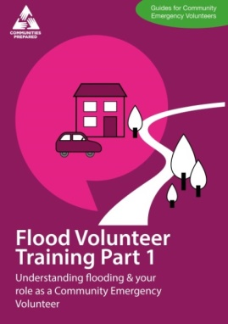
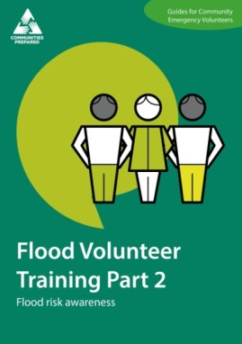
Community Flood Volunteers
In this section…
Overview of a flood volunteer
Roles and responsibilities – before, during and after a flood
See Communities Prepared Flood Volunteer training for more information

Slide 53
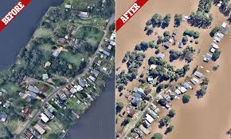
Your role before a flood
Identify:
Local flood risk
Vulnerable individuals (keep info secure)
Properties at risk
Encourage:
People at risk to register for flood alerts
Community training and activities
Raise community flood awareness
Plan:
What will you do if / when there is a flood
Ways your community can reduce flood risk
Act:
As ‘eyes and ears’ of the local authorities / responders
Support with the recruitment of volunteers.

Slide 54
Your role during a flood
Prioritise your own safety – assess the risks
Follow your emergency plan
Pass on information to the local community
Follow instructions from the emergency services
Provide the emergency services with local knowledge and information
Collect information about the flood
Ensure you have key contact details (e.g. volunteers, EA Incident Hotline and Floodline, local authority Emergency Planning team)
Do not…
Attempt to walk or drive through flood water
Attempt to operate / repair flood defence structures / equipment
Cross cordons unless given permission (by police/incident commander)
Notes:
Prioritise your own safety at all times
Your safety is a priority. Follow the guidance set out in these training modules and do not undertake activities that may place yourself or others at unnecessary risk.
Follow procedures set out in your community plan
The procedures set out in your community plan are there to ensure a co-ordinated response from the community in the event of a flood. They are also there to promote your wellbeing and that of others.
Relay information to the local community
The Emergency Services, local authorities or the Environment Agency may call upon your assistance to relay information to the community. This may be to warn the public of a potential flood and particular areas to avoid or to provide information to promote health and wellbeing. This might involve door-to-door visits to engage with individual properties.
Follow guidance from the emergency services at all times
The Emergency Services and the Police in particular take the lead during a flood event. Follow their advice at all times as you may be placing yourself and others at risk of harm if you do not. Remember, you are not a member of the uniformed emergency services. If you are told to evacuate from an area follow the guidance you are given.
Provide the emergency services with local knowledge and information
Your strength as a community volunteer is your detailed knowledge of your local area and the people living within it. Relay this information to the Emergency Services during a flood. Be mindful the information may relate to individual properties or persons and should be managed responsibly at all times.
Collect information about the flood
Information you collect and record during a flood can be important to the Environment Agency and other authorities when analysing the cause and how to reduce risk in the future. Notes and especially photographs on flow routes and water levels can be very useful. Photographs, descriptions, first property flooded and times
Avoid walking or driving through flood water
Flood water poses many different risks and dangers including; trips, slips, contamination, drowning and injury from submerged hazards.
DO NOT attempt to operate or repair flood defence structures or equipment
The unauthorised use of flood defence equipment could increase the risk of flooding or hide problems that should be addressed by the relevant authority. Similarly, do not use any equipment you have not been trained or authorised to use.
Remember – Don’t talk to the press – always report up to Co-ordinator and Co-ordinator reports to the bronze/operational commander on the ground.

Slide 55
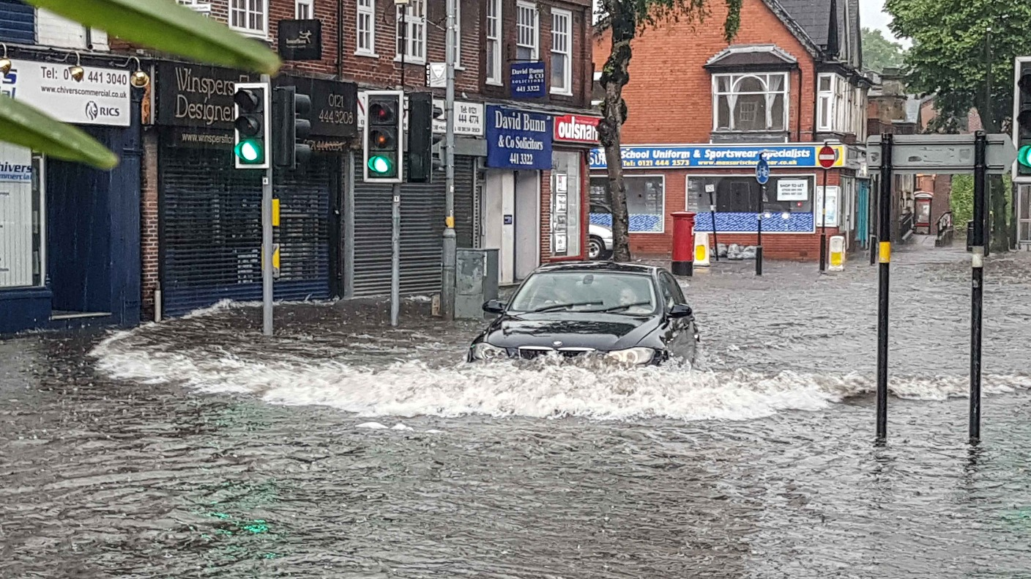
What are the dangers?
Understanding risk: what are the dangers?
Notes:
Prioritising safety is key - what are the risks here?
Potential hazards:
1 – Live traffic – car handling is badly affected in snow and vehicles can act unpredictably. Breaking distances are also extended considerably
2 – Slippery pavements – untreated surfaces can be very slippery. Ensure you are wearing boots with good grip
3 – Pollution and waste in the water. Flood water is not safe or clean.
4 – Vehicles pulling out – wheel spinning when starting can leave a vehicle out of control
5 – Hidden kerbs / level changes – you can quickly lose your footing and slip over
6 – Floating debris, particularly dangerous in fast moving waters
7 – The cold – hypothermia can quickly set in if you do not have enough layers on or get wet.
8 – Have you been trained, equipped, and feel confident to be out in these types of conditions. Are you creating a risk by being out and about?

Slide 56
Dynamic risk assessment
Pause – stop and be aware of your situation
Recognise hazards - anything that may cause harm
Identify who may be harmed, and how
Assess the risks
Identify your options
Choose the most appropriate option
Note your findings, thoughts and decisions
Enact your choice
Review the written risk assessment
Dynamic Risk Assessment
PAUSE
LOOK
THINK
ENACT

Slide 57
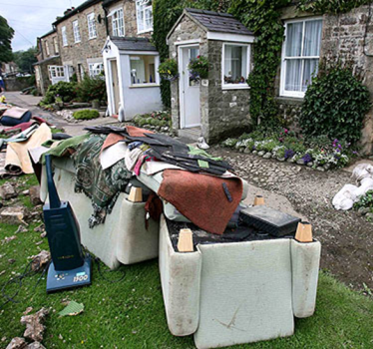
Your role after a flood
Submit flood information you have collected
Help to support and relay information to the community
Replenish and replace your group’s items as needed
Assist at community meetings
Review and update flood plan
Look for more volunteers
Update training and skills
Notes:
Really important. They may have time to do this when others might not. Take photos.
Submit information you collected about the flood (page 32 in the handbook)
Information you collect and record during a flood can be important to the Environment Agency and other authorities when analysing the cause of the flooding and how to reduce risk in the future. Submit your information to your flood plan co-ordinator. there may be other ways to submit information (CIOs, URL links for Recorded Flood Outline work, via Flood Resilience inbox) this may vary per incident and scale
Help to relay information to the local community (page 32)
You may be able to support your community by relaying useful information after a flood. Newsletters and door-to-door visits can help keep people informed after an emergency. Information may relate to personal safety, hygiene, insurance claims or the risk of further flooding.
Activity – get the group to discuss in pairs what type of information it might be useful to relay to the local community

Slide 58
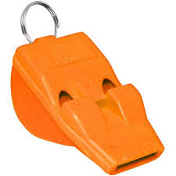
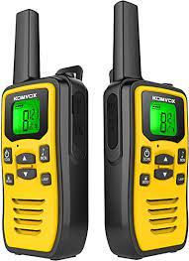
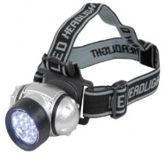
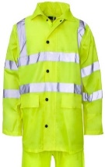
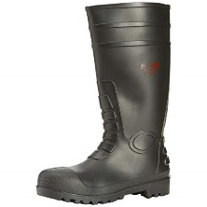
Flood Volunteer PPE
Hi-vis clothing
Wellington boots
Waterproof gloves
Head / handheld torch
Hand sanitiser
Layered clothing
Bottle of water
High energy snack
(not recommended to eat around flood water).
PPE: - Whistle
Summon HELP
Get Attention
Message
Stop Others
Notes:
Make sure that your jacket and trousers are breathable and waterproof. Your want to keep dry but you don’t want to cook in it! There are British standards you can check for when ordering.
Make sure your wellington boots provide protection from anything heavy falling on your feet.
Gloves protect your hands when you are picking things up but they also protect you from coming into contact with contaminated water as well.
A head torch helps you to see what you are doing when you are working at night.
Hand sanitiser is useful first step to clean your hands if you have come into contact with flood water or you want a drink or something to eat when on duty. Always have a shower after a call out anyway.
Depending on the time of year you may wish to put on several layers to keep yourself warm when you are working.
A bottle of water will keep you hydrated. Being on duty for several hours can be thirsty work. Also have a chocolate bar or something similar in your pocket to give your energy levels a boost during your shift.
Refer back to Incident Management Part 2 handbook (p.18): Safety equipment
Your high visibility jacket or vest should be worn outside of your clothing and securely fastened at the front to prevent the jacket flapping in the wind or catching on anything and placing you at risk.
Ensure you are visible to others at all times. Use a torch when working in the dark or low light conditions.
The safety equipment you use should be identified through undertaking a risk assessment as part of your community flood or emergency plan.
The EA can provide hi viz and a name badge. Other items may need fundraising for your group to purchase

Slide 59
Community flood preparedness in Rotherham
Parish Council Consortium
Anston, Dinnington, Todwick, Thurcroft, Catcliffe and Woodsetts Parish Councils
£66k secured from South Yorkshire Community Foundation
To fund items to be shared across parishes, such as flood kits, pumps, storage containers, temporary emergency shelter resources, generator, portable lighting
Complements the strategic response
Features a training and capacity building programme for successful delivery
Potential to develop flood action group/s or flood warden schemes
Notes:
Hand over to Martin

Slide 60
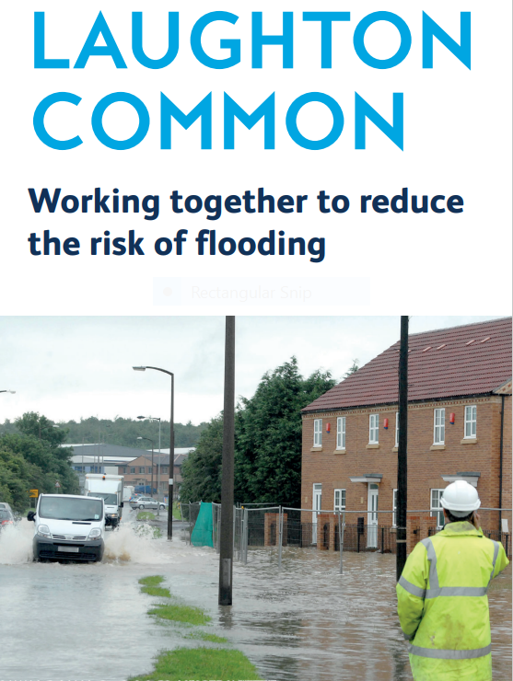
Community flood preparedness in Rotherham
Dinnington / Laughton
Equipment purchased via the SYCF funding
‘Connected by Water South Yorkshire’ pilot scheme with RMBC and Dinnington St. Johns Town Council. Leaflet for local residents produced, outlining roles and responsibilities.
Joint response to storms in February 2022 – Town Council deployed hydro-sacks, etc.
Next step – ‘table-top’ exercise with to develop a better understanding of roles and ensure effective co-ordination when it comes to activating the emergency plan.

Slide 61
Community flood preparedness in Rotherham
Whiston
Parish Council has secured £12k from South Yorkshire Community Foundation.
Regular meetings / community events taking place between Ward Councillors, Parish Council, RMBC Drainage Team, Environment Agency and Yorkshire Water.
Clean up of Whiston Brook to take place
Next step - priority location for joint working under the Connected by Water South Yorkshire initiative

Slide 62
Next steps
Understand the need for, and roles of, volunteers / groups
Recruit volunteers
Linking into the local community (e.g. parish council) – know who to speak to
Consider the need for insurance
Develop your community plan
Look for training opportunities – diversify skills
Plan what kit you need
Notes:
PPE:
Hi-vis clothing
Wellington boots
Waterproof gloves
Head / handheld torch
Hand sanitiser
Layered clothing
Bottle of water
High energy snack (not recommended to eat around flood water)
Whistle

