Slide 1

Is there another way to reverse decline?
WHITEHAVEN
A Living Lab for Change

Slide 2


Slide 3

Attract & retain “talent”
Constant physical renewal
New ideas & Innovation
MAG
NET
ISM
Attract Investment
Strong leadership
Physical & digital connectivity
Strong sense of identity

Slide 4

To create and lead E-Revolution 5.0
Changing the future, while celebrating the past. A people-centred approach to harnessing emerging technology, creating a SMART PLACE

Slide 5

It’s about joining the dots - combining investment, direction, and ambition, while opening doors to new ideas and opportunities…but what does that mean?

Slide 6

NEW BEGINNINGS
NEW THINKING
NEW MODEL
NEW OPPORTUNITIES
NEW DEGREE
NEW DIGITAL GRID
NEW NETWORK
NEW EV INFRASTRUCTURE

Slide 7







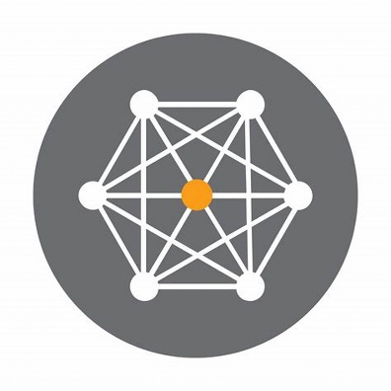










Whitehaven HIVE Model
MAGNETISM
Inclusion, Investment, Improvement
E-Revolution 5.0
Social & Physical Change
Social & Physical Change
New businesses
Projects & ventures
MA (Disruption)

Slide 8
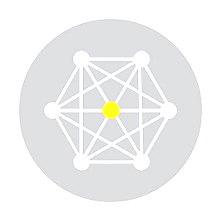
Digital GRID
As one of Europe’s first planned grid towns, it is only fitting that Whitehaven is home to one of the world’s first digital grids
SMART CITY TECHNOLOGY TO DRIVE DIGITAL CHALLENGE, CHANGE AND UPTAKE

Slide 9
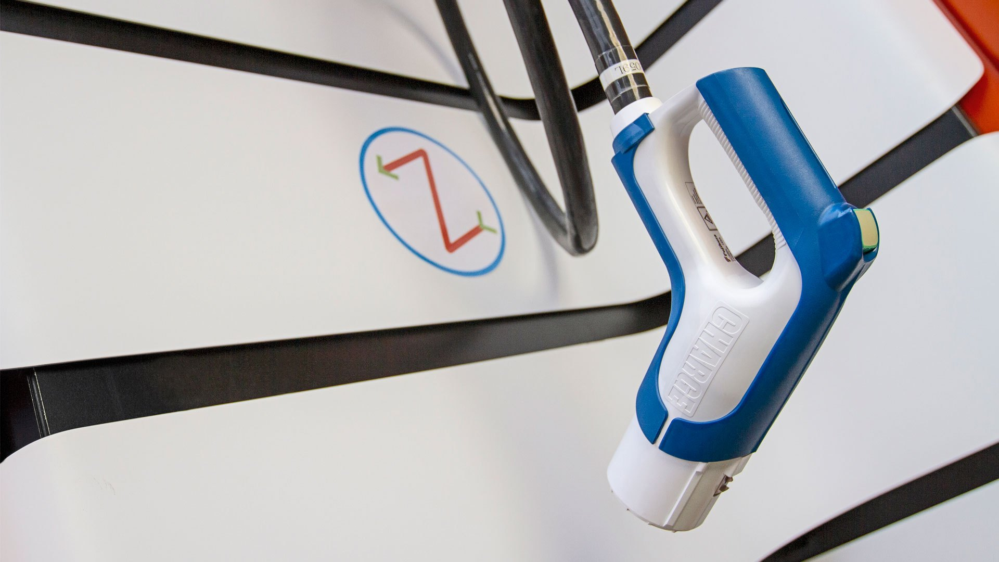
Working in partnership with Zapinamo, SSE, Copeland BC, Sellafield and BEC to create the country’s most complete EV infrastructure and vehicle uptake/use case

Slide 10


Slide 12


Slide 13

andrea.winders@disruptieve.com

